Slide 1
Author: Alessandro Ferro
ICTWEB503
Task 2
Student ID: 83126277

Slide 2
1. how hypertext transfer protocol (HTTP) works when developing web applications:
Implications of hypertext transfer protocol (HTTP)
HTTP is the protocol used to transfer files on the World Wide Web
The resources transferred can be: Hypertext, CSS, Hypermedia, Hyperlinks, Scripts.
A client send a request resources to a web server, the web server process the request and send back a response.
HTTP is stateless. Each client request is treated by the server as a new one and no information about previous requests is stored by the server.

Slide 3
HTTP Statelessness is an obstacle to two way interactivity and personalization.
Many applications nowadays, offer to the user interactive and personalized experiences. Several ways to work around HTTP statelessness have been introduced to create stateful apps.
Some of the ways to implement stateful applications are:
Sessions
Cookies
AJAX
A stateful application is that one that provides content that is dynamic and specific to the user

Slide 4
Sessions
When the server send a response to the client, it appends some form of unique session identifier that is used by the client every time it sends a new request to the server.
The server creates a session; a file in a temporary directory where it stores the session variables and their values.
When the server receives a request, it checks for an identifier, checks if the identifier is still valid and if both the conditions apply, retrieves the data related to that session id and send them back as a response.
A session ends a certain amount of time after the user left the website.
Sessions are a way to simulate persistence in the http client-server model. In reality each transaction is still treated as completely separated from the other ones.

Slide 5
Cookies
When the server receives a request, it creates text files (the cookies) that are then sent back to the client. The cookies are stored on the client side.
Cookies contain small amount of data useful to identify the user. For example they can be sent from the client to the server to identify a session (session identifier).
When the website, or the browser are closed by the user, the cookies still exist. They can be deleted manually by the user or would automatically expire after a set amount of time.
Cookies are independent from session, but session depend on cookies.

Slide 6
AJAX
AJAX allows to update asynchronously a webpage without reloading the same page.
The client (browser) sends a request to the server, the server processes the request and sends back the data as in the normal request-response model.
The only difference is that the response is processed by a call-back JavaScript function that will update the page without needing to refresh it entirely.
This technique is very powerful because it allows the client to request only the specific data to the server, reducing the traffic and speed up significantly the experience for the user.

Slide 7
Limitations of hypertext transfer protocol (HTTP)
HTTP/1.0
Each request-response cycle can transfer just one file
HTTP lack the security layer provided by HTTPS
It implements only GET, HEAD and POST methods, which doesn’t allow to maintain and edit files directly on the server (problem solved with http 1.1 which also implement PUT, DELETE and META HTTP-EQUIV).
Some web servers can run several virtual servers. When the physical web server is reached by a request, it can know which virtual server is needed by checking the “Host” header field in the request.

Slide 8
HTTP/1.1
The distance the data have to travel highly impact the latency in loading a web page
Requests get stuck on the same connection until the previous one is resolved causing head of line blocking
It uses multiple connections for multiple resources. Hard to setup and to manage
Different resource request for each resource file
Resources are returned in the order they have been requested
Long HTTP headers which causes delay in web page loading
Request and responses are not compressed

Slide 9
HTTP/2
Not all browsers support HTTP/2
HTTP/2 uses encryption by default. Sites that do not use HTTPS need to implement it before they can switch to HTTP/2
Switching to HTTP/2 requires time and resources and for some already speed optimized websites, the increase in performance would be minimal.

Slide 10
Advantages of HTTP/HTTPS
The World Wide Web offers an already available infrastructure
Browsers can debug, test and use an application
Web caching decreases traffic, latency and reduces the amount of work of the web server. If the remote server is down, there are also chances it can still provide a copy of the resources requested.
Support of data compression
HTTPS offers an extra layer of security
Content negotiation allows to provide the same resource in different format
Firewall traversal makes the content available from most locations
Vastity of tools available, developed with HTTP in mind.

Slide 11
HTTP/2 has encryption by default, improving security
Mobile sites are allowed to prevent data bytes download, enabling headers compression.
A server can send multiple responses to the original request
Fully enables multiplexing, to send multiple requests on the same connection
The web server can respond to requests in any order
Can break the files in smaller pieces.
It is compatible with HTTP/1.1
Load web ages faster.
On top of the advantages already mentioned, there are additional improvements specific to HTTP/2 that are worth mentioning.

Slide 12
2. Implementation of session management
Concepts behind session management
Session management is the process of securing client-server interactions while making the application work in a stateful manner.
Due to HTTP being stateless, sessions are a responsibility of web applications.
Sessions can possibly be appropriated by hackers, raising security concerns
Transactions that handle very sensitive data should be secured with two-factor authentication (e.g. bank transfers)

Slide 13
User authentication information can be used as the identifier passed between server and client
A value assigned to an HTML hidden field (not secure)
URL rewriting, to pass a parameter in the URL every time (tedious and prone to errors)
A cookie can be passed in the request and response headers between the client and the server.
Session management API creates a session object specific to the session
To ensure continuity in the stateless conversation between client and server, sessions make use of unique identifiers passed back and forth. There are several ways to achieve this.

Slide 14
Server-side scripting requirements
The server side script is responsible to create a session and the related session identifier.
Sessions are destroyed upon logout
Sessions timeout after a specified period of inactivity
Session id is never disclosed
Session id is changed on login and reauthentication
The only session id accepted are those ones created by the application
The session information are available for the entire duration of the session.

Slide 15
Features-of server side scripting
Server side code is the code used to process the requests made by the client
Authenticate the user against the credentials stored in a database
Create or retrieve cookies and set their longevity
Create session objects and getters and setters for their attributes
A session object can set the longevity of the session and can invalidate the session
Session objects are identified using a cookie
If cookies are disabled it can use URL rewriting to pass information in the URL

Slide 16
Advantages and disadvantages of session management
Advantages
By recording user specific data, sessions allow to maintain state throughout the application for all the duration of the session
Sessions are easily implemented with cookies and session objects
Data from each client are stored separately
Sessions are a secure and transparent way to handle user data and maintain state.
Disadvantages
Session data are stored in the server memory and can cause performance overhead
Session objects need to be serialized and deserialized, possibly causing overhead

Slide 17
Authentication requirements of session management
Sensitive data shouldn’t be stored in cookies
Cookies should always be set to expire after a certain amount of time
Session timeouts and session re-authentication should be implemented
Session ID should never be disclosed outside of cookie headers
Session ID should be changed on login and on re-authentication to prevent session fixation
Session tokens should be long and generated randomly
The use of concurrent duplicate sessions from different machines shouldn’t be allowed
Tokens should be flagged as HttpOnly and Secure

Slide 18
User’s interaction with the website
The website can either provide static or dynamic content to the users
The content of the website is publicly accessible to all visitors
Every user access the same content
Visitors of a website can access its content, but have no way to manipulate it
The website doesn’t necessary need users authentication. Authentication and authorization can be used for subscriptions or to provide additional content or options.
The website doesn’t necessarily need to session management.
The website provides links to navigate through the pages.

Slide 19
User’s interaction with the web application i.e. shopping cart
The web application is created to interact with the users
The user can not only access the data, but also manipulate them
The data provided by web applications are dynamic and specific to the user
Web applications do require security measures such as authentication and authorization.
Web applications can handle personal and sensitive data
Any point of access the user has with the application (input) represents a vulnerability and a possible exploit and shouldn’t be trusted.

Slide 20
3. Creating a shopping cart
What is a shopping cart?
A shopping cart is software that records the items chosen by the potential buyer of an ecommerce website
A user can browse products, add them to the cart, review the products in the cart and remove them from the shopping cart.
The shopping cart should provide an option to checkout
The shopping cart keeps track of the items while the user browses the website

Slide 21
How does the shopping cart works?
When a user logs-in into the website, a session is initialized.
A cookie can be assigned to persist data in between different sessions, or the data can be stored in a database.
Information about the session activity are stored in the session variables.
These information include the products added to the shopping cart by the user, their relative information (price, quantity, etc.) and possibly information about the user.
When the user close the browser, or when the session expires by configuration, the session is destroyed with all the relative data.
Modern technologies allow to implement data persistency on the client side as well (e.g. HTML5 web storage).

Slide 22
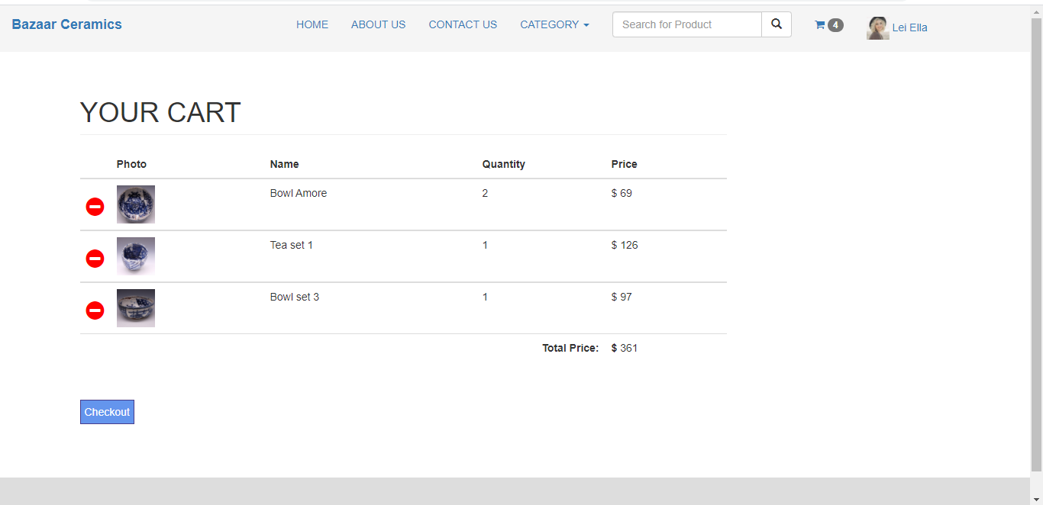
The layout of the shopping cart

Slide 23
Technology requirements for the shopping cart
The application will be hosted on an apache web server. To reflect this choice the development environment will be xampp.
The backend of the application will be written in PHP.
Data persistency will be implemented on the server side and will be achieved by the use of session variables.
Data will be stored in a relational database (MariaDB) that will be queried by the application upon request from the clients.
On the client side, data will be displayed to the user in an html tables
Styling will be achieved with a blend of standard CSS and Bootstrap as a CSS library.

Slide 24
Latest workplace instructions, technical documents or industry guidelines
Due to the relevance of mobile devices nowadays, the application will have to be responsive.
The shopping cart will provide the user with information about the products it contains, such as the quantity for each product, an image, the name of the product, the partial total price and the total price.
The application will allow user that didn’t sign in to add products to the shopping cart.
If a user is not logged in, instead of a checkout button, there will be a prompt to login to proceed with payment.

Slide 25
Documentation requirements for the application, with particular references to its management of statelessness.
The documentation that will be provided to the client will describe the functionalities of the web application, the technologies used for its implementation and the strategies adopted for session management.
The functionalities section will describe what the application can do from a user perspective.
The technologies used section will describe how the functionalities have been implemented.
The session management section will focus on how the data transferred over the http protocol are persisted through multiple request-response cycles and will address any concern related to security and how they have been handled.

Slide 26
Feedback and suggestions from the client and manager
To better ensure the client satisfaction with the software produced, an iterative approach to development will be adopted.
A first version of the product will be delivered to work both as a prototype and a MVP.
The manager and the client will have a chance to review the product and to give their feedback.
Any change or new feature requested would be implemented in the following iteration.
The process will be repeated until the requirements agreed upon will be satisfied or until the product will receive positive feedback from the manager and the client.

Slide 27
4. Coding Requirements
Discuss the HTML requirements
The HTML pages will be produced to be compatible across the most used browser.
The HTML pages will be produced in adherence with the relevant accessibility standards
For any input provided by the user, HTML tags attributes will be the first layer of validation implemented.
The HTML produced will comply with the standards dictated by the World Wide Web Consortium (W3C).

Slide 28
Discuss the CSS3 requirements
To guarantee a uniform and consistent look throughout the web application, Bootstrap will be adopted as the CSS framework.
Any additional styling that might be required over that one provided by Bootstrap, will be implemented by using a separated CSS file.
Bootstrap will be provided through a CDN
Whenever possible the HTML elements will be referred to by their class name. The use of IDs, if not avoidable will be kept to a minimum.

Slide 29
Discuss functional and non-functional requirements
Functional Requirements
A user can add products to the shopping cart
A user can specify the quantity for each product added to the shopping cart
A user can view the products in the shopping cart
A user can modify the quantity for each product in the shopping cart
A user can remove products from the shopping cart
The shopping cart calculate the partial and total price
A user can select a payment method
A user can pay.

Slide 30
Non functional requirements
Reliability: the system’s operation should be successful at least 99.5% of the times.
Availability: system uptime should be 24 hours/day.
Security: to be accessed, the system should require user authentication.
Performance: the system load time shouldn’t exceed three seconds.
Usability: a new user should be able to purchase a product within one minute and should be able to access any page in no more than four clicks.
Responsiveness: The system should be designed to be displayed also on mobile devices.

Slide 31
Discuss the dynamic client and server-side requirements
The system should keep track of the user actions for the duration of the session.
Data should be persisted for the duration of the session.
The information displayed should be contextual and specific to each particular user.
The data for each session should live in the server for the duration of the session.
The shopping cart icon should show how man items are in the shopping cart.

Slide 32
5. Review and debugging the code (when, where and how)
To ensure web application is developed according to the obtained requirements
A good idea is to test every smaller module of code implemented during development. A common way is to do unit testing using automated testing tools.
Other viable options are white box testing, executed by other programmer (who can either know, or not know the details of the application) or black box testing.
Considering that the application is reasonably small, the developer itself can execute iterated tests during development to ensure that each component is working as expected.
Code reviews should also be implemented often.

Slide 33
To ensure web application keeps track of user data between browser requests
One of the fundamental aspects of a web application is the possibility to keep track of the user actions and status during each session.
The developer will test the session management strategy adopted organically throughout development, as it is one of the core parts of the business logic.
However the correct behaviour of the application taken as an individual entity, separated from the rest of the website, is meaningless. Therefore, once all the different components that constitute the software are completed, integration testing should be performed to ensure that by working together, they produce the expected results and behaviours.

Slide 34
To ensure web application is developed in a stateless environment
When a user logs-out or closes the browser, all of its stored information should be deleted.
If the user start the application again, there should be no track on the server of any past interaction with that user.
Only when the user logs-in a session is started anew and the communication between server and client is kept stateful by implementing sessions.
An unauthenticated user accessing the application will have access only to limited functionalities..

